Slide 1
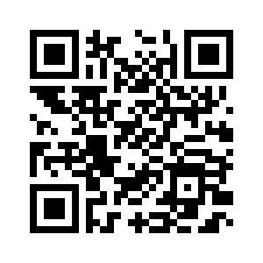
Week 1 Survey (The Same Survey as Last Friday)
Please take this survey if you haven’t
2% of your 5% participation score (a free 2% as long as you take it)
No need to fill out the survey again if you did it on last Friday
https://forms.gle/k7Kv8cc2q2BenXsF8

Slide 2
CS97: Introduction to Data Science
08: Support Vector Machine
Instructor: Shichang Zhang
shichang@ucla.edu

Slide 3
So far …
Classification models
Logistic regression
KNN

Slide 4
Next
A more sophisticated classification model (Support Vector Machine) that considers the concept of margin

Slide 5
Support Vector Machine
Introduction
Linear SVM
Non-linear SVM

Slide 6
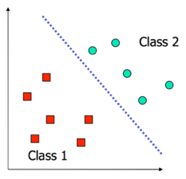
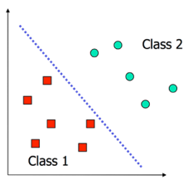
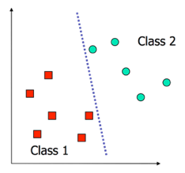
Decision Boundaries Revisited
In logistic regression, we learn a decision boundary that separates the training classes in the feature space.
When the data can be perfectly separated by a linear boundary, we call the data linearly separable.
In this case, multiple decision boundaries can fit the data. How do we choose the best?
Question: What happens to our logistic regression model when training on linearly separable datasets?
Notes:
1/(1+e^-x), 1/(1+e^-2x), 1/(1+e^-3x), …

Slide 7
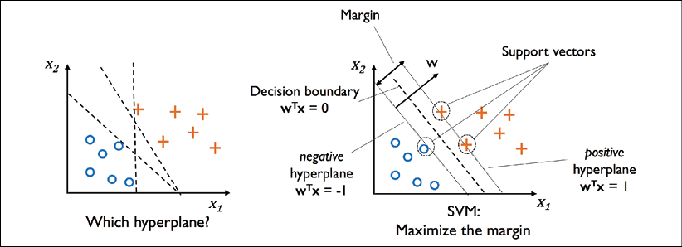
Principle of Max Margin

Slide 8
Now that intuition is clear…
How do we formulate this notion of max margin mathematically?

Slide 9
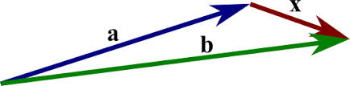
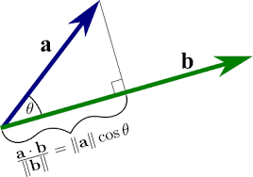
Math Review
Vector
$x=\left(x_{1},x_{2},…,x_{n}\right)$
Subtracting two vectors: $x=b−a$
Dot product
$a⋅b=∑a_{i}b_{i}$
Geometric interpretation: projection
If $a and b$ are orthogonal, $a⋅b=0$

Slide 10
Exercise
(1,0), (0,2)
Dot product = (1,0) . (0,2) = 0 + 0 = 0

Slide 11
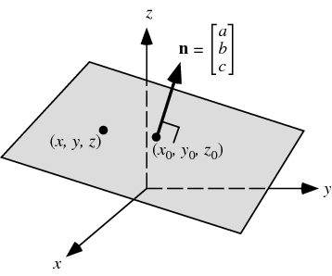
Math Review (Cont.)
Plane/Hyperplane
$a_{1}x_{1}+a_{2}x_{2}+…+a_{n}x_{n}=c$
Line (n=2), plane (n=3), hyperplane (higher dimensions)
Normal of a plane
$n=\left(a_{1},a_{2},…,a_{n}\right)$
a vector which is perpendicular to the surface

Slide 12
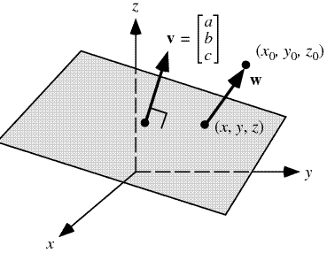
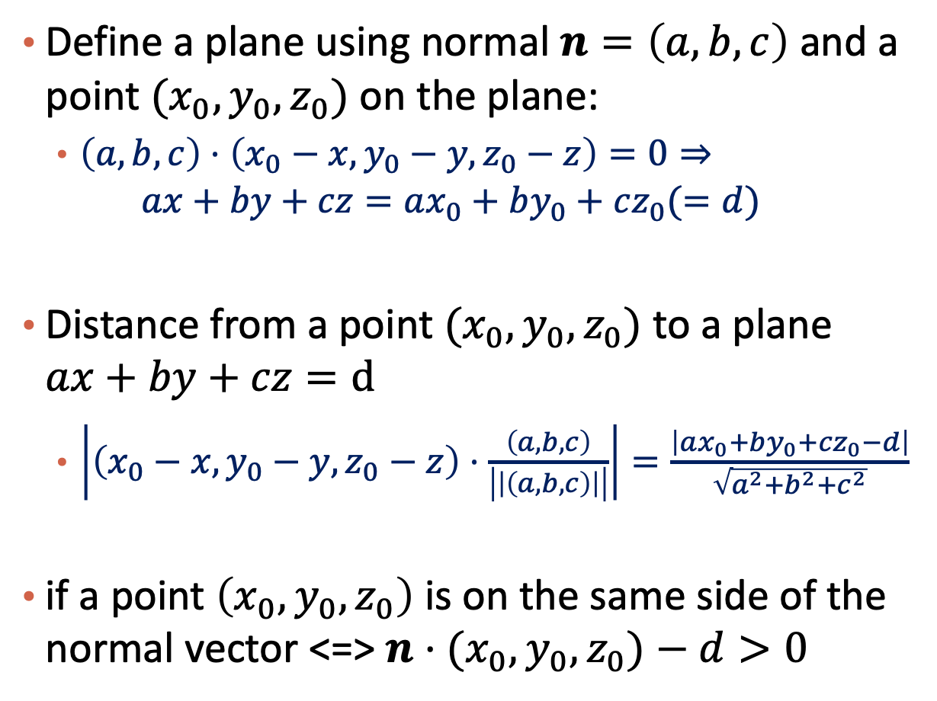
Math Review (Cont.)
Define a plane using normal $n=\left(a,b,c\right)$ and a point $(x_{0},y_{0},z_{0})$ on the plane:
$\left(a,b,c\right)⋅\left(x_{0}−x,y_{0}−y,z_{0}−z\right)=0⇒$
$$ax+by+cz=ax_{0}+by_{0}+cz_{0}(=d)$$
Distance from a point $(x_{0},y_{0},z_{0})$ to a plane $ax+by+cz=d$
$\left|\left(x_{0}−x,y_{0}−y,z_{0}−z\right)⋅\frac{\left(a,b,c\right)}{\left|\left|\left(a,b,c\right)\right|\right|}\right|=\frac{\left|ax_{0}+by_{0}+cz_{0}−d\right|}{\sqrt{a^{2}+b^{2}+c^{2}}}$
if a point $\left(x_{0},y_{0},z_{0}\right)$ is on the same side of the normal vector <=> $n⋅(x_{0},y_{0},z_{0})−d>0$

Slide 13
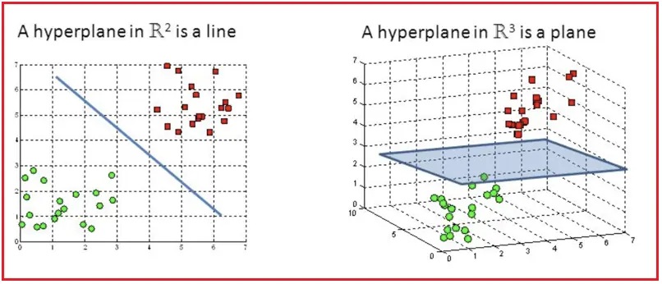
Hyperplane

Slide 14
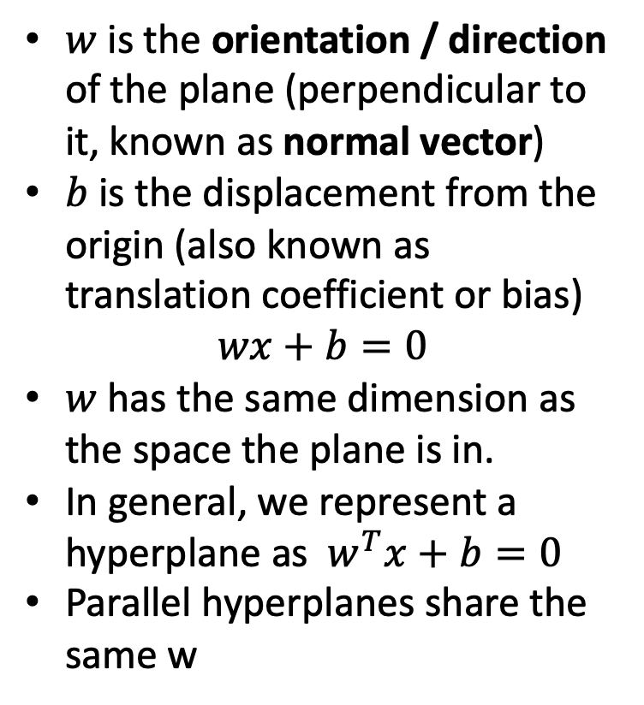
Two Parameters of a Hyperplane
$w$ is the orientation / direction of the plane (perpendicular to it, known as normal vector)
$b$ is the displacement from the origin (also known as translation coefficient or bias)
$$wx+b=0$$
$w$ has the same dimension as the space the plane is in.
In general, we represent a hyperplane as $w^{T}x+b=0$
Parallel hyperplanes share the same w
w
w

Slide 15
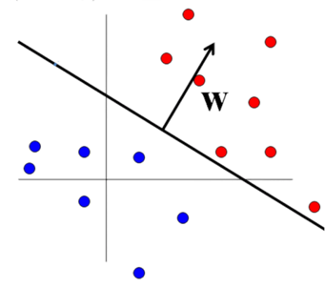
Geometry of Decision Boundaries
Recall that the decision boundary is defined by some equation in terms of the predictors. A linear boundary is a hyperplane defined by:
w⊤x + b = 0 (General equation of a hyperplane)
where w={w₁, w₂, …, w_{p}} is a weight vector and b a scalar (bias)
w, represent a normal vector, pointing orthogonally away from the plane

Slide 16
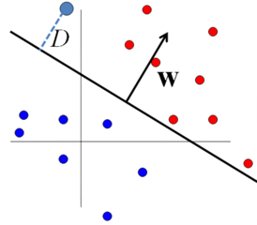
Geometry of Decision Boundaries (cont.)
Now, using some geometry, we can compute the distance between any point to the decision boundary using w and b.
The signed distance from a point $x∈ℝ^{n}$ to the decision boundary is (Euclidean Distance Formula)
How to decide the sign?

Slide 17
Margins and Support Vectors
The points closest to the decision boundary are called support vectors
Margin: (twice) the distance of the boundary to its support vectors
Small Margin
Large Margin
Support Vectors

Slide 18
SVM—When Data Is Linearly Separable
m
Let data D be (X₁, y₁), …, (X_{|D|}, y_{|D|}), where X_{i} is the set of training tuples associated with the class labels y_{i}
There are infinite lines (hyperplanes) separating the two classes but we want to find the best one (the one that minimizes classification error on unseen data)
SVM searches for the hyperplane with the largest margin, i.e., maximum marginal hyperplane (MMH)

Slide 19
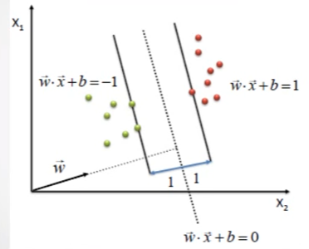
Maximizing Margins
The points closest to the decision boundary are called support vectors.
For any plane, we can always scale the equation:
w⊤x + b = 0 so that the support vectors lie on the planes:
w⊤x + b = ±1,
depending on their classes.

Slide 20
Why w⊤x + b = ±1
Any line can be represented with scaled w and b
$e.g., 2x_{1}+3x_{2}+1=0$
w = (2,3), b = 1
w = (4,6), b = 2
w = (6,9), b = 3
w = (20,30), b = 10
If we choose another constant c rather than 1, both sides can be divided by c and the right-hand side becomes 1.

Slide 21
Maximum Margin Calculation
w: decision hyperplane normal vector
x_{i}: data point i
y_{i}: class of data point i (+1 or -1)
Formula for distance :
ρ
w^{T}x_{a} + b = 1
w^{T}x_{b} + b = -1
$$margin: ρ=\frac{2}{||w||}$$
Hint: what is the distance between $x_{a}$ and
w^{T}x + b = -1
w^{T} x + b = 0
Notes:
x’y=||x||*||y||*cos(\theta)

Slide 22
SVM as Constrained Optimization
We have formulated previous machine learning problems using loss functions and optimization algorithms
What’s the loss function for SVM? (hint: SVM is based max margin)
Complication: SVM’s objective function has constraints / restrictions
ρ
w^{T}x_{a} + b = 1
Objective: Find w and b such that $ρ=\frac{2}{||w||}$ is maximized;
Constraints: For all {(x_{i} , y_{i})}
w^{T}x_{i} + b ≥ 1 if y_{i}=1;
w^{T}x_{i} + b ≤ -1 if y_{i} = -1
w^{T}x_{b} + b = -1
w^{T} x + b = 0

Slide 23
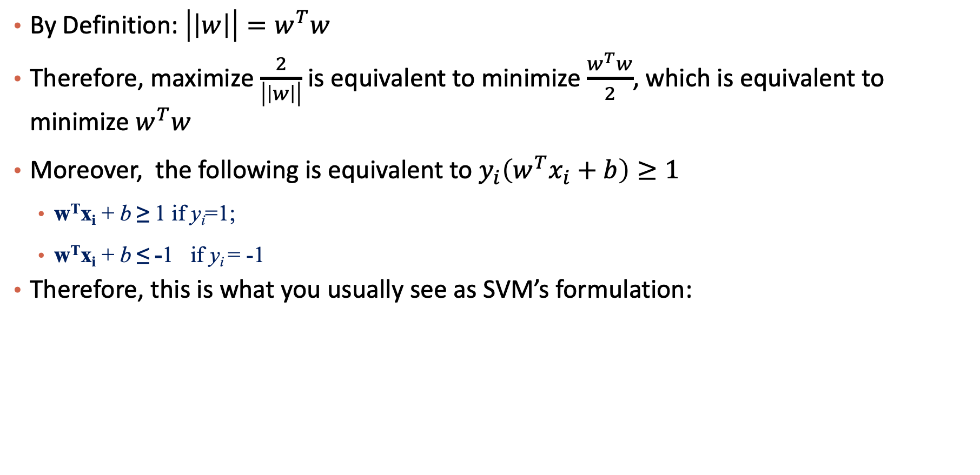
Some linear algebra results in…
By Definition: $\left|\left|w\right|\right|=w^{T}w$
Therefore, maximize $\frac{2}{\left|\left|w\right|\right|}$ is equivalent to minimize $\frac{w^{T}w}{2}$, which is equivalent to minimize $w^{T}w$
Moreover, the following is equivalent to $y_{i}\left(w^{T}x_{i}+b\right)≥1$
w^{T}x_{i} + b ≥ 1 if y_{i}=1;
w^{T}x_{i} + b ≤ -1 if y_{i} = -1
Therefore, this is what you usually see as SVM’s formulation:
Objective: Find w and b such that $w^{T}w$ is minimized;
Constraints: For all {(x_{i} , y_{i})}, $y_{i}\left(w^{T}x_{i}+b\right)≥1$

Slide 24
SVM and Convex Optimization
As a convex optimization problem SVM has been extensively studied and can be solved by a variety of algorithms:
(Stochastic) libLinear Fast convergence, moderate computational cost
(Greedy) libSVM Fast convergence, moderate computational cost
(Stochastic) Stochastic Gradient Descent Slow convergence, low computational cost per iteration
(Greedy) Quasi-Newton Method Very fast convergence, high computational cost

Slide 25
The Optimization Problem Solution
The solution has the form:
Each non-zero α_{i} indicates that corresponding x_{i} is a support vector.
α_{i} is from optimization, don’t need to worry about it
Then the classifying function will have the form:
Notice that it relies on dot product between the test point x and the support vectors x_{i}
We will return to this later.
Also keep in mind that solving the optimization problem involved computing the dot products x_{i}^{T}x_{j} between all pairs of training points.
w =Σα_{i}y_{i}x_{i} b= y_{k}- w^{T}x_{k} for any x_{k} such that α_{k}≠ 0
ρ
w^{T}x_{a} + b = 1
w^{T}x_{b} + b = -1
f(x) = Σα_{i}y_{i}x_{i}^{T}x + b
w^{T} x + b = 0
Notes:
The values of alphas need to be drawn more clearly

Slide 26



Please download and install the Slido app on all computers you use
Audience Q&A Session
ⓘ Start presenting to display the audience questions on this slide.

Slide 27
Support Vector Machine
Introduction
Linear SVM
Non-linear SVM

Slide 28
Non-linear SVMs
Sec. 15.2.3
Datasets that are linearly separable (with some noise) work out great:
But what are we going to do if the dataset is just too hard?
How about … mapping data to a higher-dimensional space:
0
x
0
x
x²
0
x

Slide 29
Non-linear SVMs: Feature spaces
Sec. 15.2.3
General idea: the original feature space can always be mapped to some higher-dimensional feature space where the training set is separable:
Φ: x → φ(x)

Slide 30
Another visualization
“lift up” your space so that data becomes linearly separable in higher dimensional spaces.
This is achieved using the mathematical magic called “kernel trick”!
You will learn this trick in college.
For now, get the intuition and we will just look at one formula only.

Slide 31
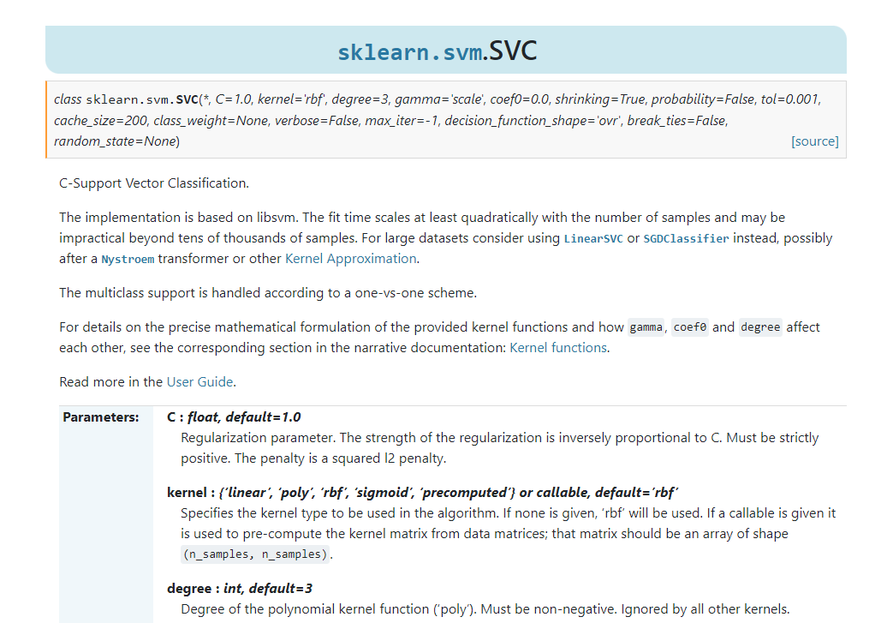
SVM: Kernel Function Choices
“poly”: polynomial kernel function
“rbf” : Gaussian kernel
“sigmoid”: logistic kernel
A hyperparameter for the sklearn class
Here “SVC” means “Support Vector Classifier”.

Slide 32
Summary
Linear SVM
Classifying Linear Separable Data
Margin, support vectors
Non-linear SVM
Kernel trick

Slide 33
Please download and install the Slido app on all computers you use
Audience Q&A Session
ⓘ Start presenting to display the audience questions on this slide.

